Slide 1

Validate Validate Network Telemetry Messages Implementations IETF 124 Hackathon, November 1-2nd 2025
NMOP & NETCONF WG

Slide 2

Hackathon Plan, Software and Website
Test Plan
Message Broker integration
Validate draft-ietf-nmop-message-broker-telemetry-message for draft-ietf-nmop-yang-message-broker-integration integration against YANG schema with yanglint
Software
YANG-Push Publisher - Cisco IOS XR
YANG-Push Publisher - 6WIND VSR
YANG-Push Publisher - Huawei NE (Router) and MA (OLT)
YANG-Push Receiver – Netgauze
YANG-Push Receiver – Pmacct
udp-notif dissector - Wireshark
NMOP & NETCONF WG
https://www.network-analytics.org/yp/how-to-deploy.html

Slide 3
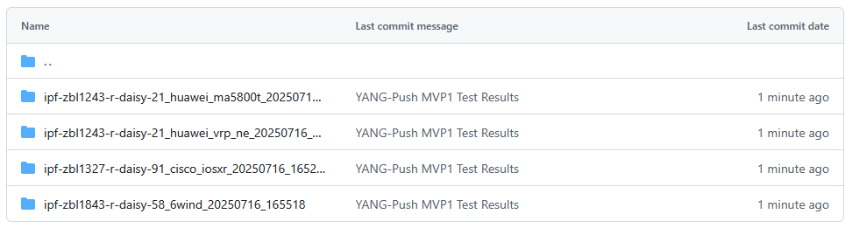
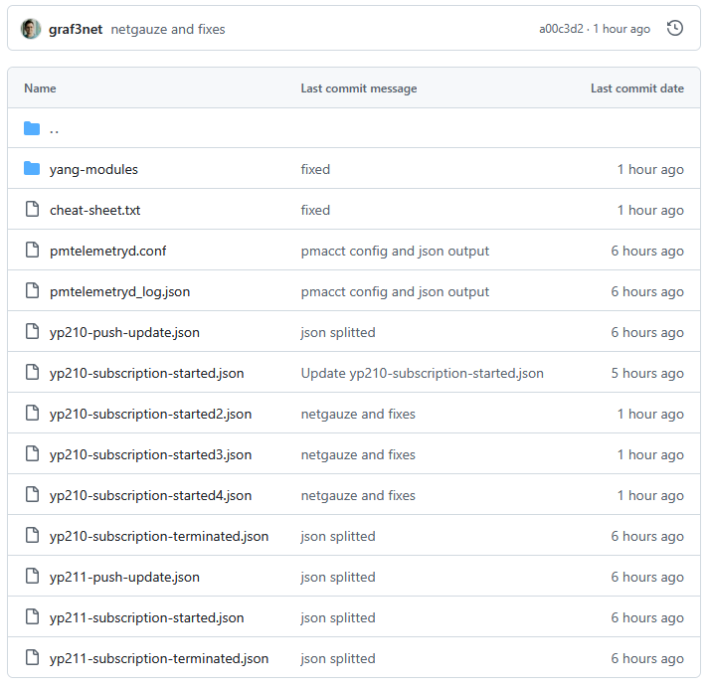
Hackathon – Repositories
YANG-Push Test Result Repository
https://github.com/network-analytics/ietf-network-analytics-document-status/tree/main/123/Hackathon
Packet capture on the wire
Netconf RPCs and YANG-Push JSON and CBOR encoded messages
Telemetry Message Test Result Repository
https://github.com/network-analytics/ietf-network-analytics-document-status/tree/main/124/Hackathon
Pmtelemetryd configuration and JSON telemetry messages
YANG schemas for validation
Apache Kafka Integration
https://github.com/network-analytics/yang-kafka-integration
YANG Serializer
YANG Schema Registry Plugin
NMOP & NETCONF WG

Slide 4
An Architecture for YANG-Push to Message Broker Integration draft-ietf-nmop-yang-message-broker-integration draft-ietf-nmop-message-broker-telemetry-message draft-netana-nmop-yang-message-broker-message-key
+------------------------------------------------------------+
| Data Storage |
+------------------------------------------------------------+
^
| (12) Ingest Data
| According to Schema
+------------------------------------------------------------+
| Data Consumer |
+------------------------------------------------------------+
| ^ ^
(10) Get | | | (9) Validate
Schema | | | Serialized Message
| | | Schema on Consumer
| | +--------------------+
| | | Message |
| | | Broker |
| | +--------------------+
| | ^
| | | (8) Serialize
| | (11) Issue | YANG-Push Message
| | Schema | annotated Schema
v | (6) Post | ID on Producer
+--------------------+ Schema +--------------------+
| YANG | <--------------- | Data Collection |
| Schema Registry | ---------------> | YANG-Push Receiver |
+--------------------+ (7) Issue +--------------------+
| Schema ID | ^ (3) Receive
| | | YANG-Push
v (4) Discover | | Subscription
+--------------------+ Schema | | Start Message
| Stream | Dependencies | | ^
| Catalog | and Obtain | | | (5) Publish
+--------------------+ Schemas | | | YANG-Push
| | | Message
| | | with
(1) Discover | | | Subscriber
Notification v | | ID
+--------------------+ Capabilities +--------------------+
| Manage YANG-Push | ---------------> | Network Node |
| Subscription | ---------------> | YANG-Push Publisher|
+--------------------+ (2) Subscribe +--------------------+
Subscription to YANG Notifications RFC 8639
Subscription to YANG Notifications for Datastore Updates RFC 8641
UDP-based Transport for Configured Subscriptions draft-ietf-netconf-udp-notif
Subscription to Distributed Notifications draft-ietf-netconf-distributed-notif
Extensible YANG Model for YANG-Push Notifications draft-ietf-netconf-notif-envelope
Support of Versioning in YANG Notifications Subscription draft-ietf-netconf-yang-notifications-versioning
YANG Modules Describing Capabilities for Systems and Datastore Update Notifications RFC 9196
YANG Notification Transport Capabilities draft-ietf-netconf-yp-transport-capabilities
YANG Library RFC 8525
Augmented-by Addition into the IETF-YANG-Library draft-ietf-netconf-yang-library-augmentation
Validating anydata in YANG Library context draft-netana-nmop-yang-anydata-validation
Encoding of Data Modeled with YANG in the CBOR RFC 9254
NMOP & NETCONF WG

Slide 5
Libyang – Anydata Validation Support
root@daisy-playground-rh8 [ /tmp/hackathon ] () # yanglint-devel -i -t ext yang-modules/ietf-subscribed-notifications.yang yang-modules/ietf-yang-push-revision.yang yang-modules/ietf-yang-push.yang yang-modules/ietf-datastores.yang yang-modules/ietf-udp-notif-transport.yang yang-modules/ietf-yang-push-telemetry-message.yang yang-modules/ietf-telemetry-message.yang yang-modules/ietf-yang-types.yang yang-modules/ietf-yang-revisions.yang yang-modules/ietf-yang-semver.yang yang-modules/ietf-yang-structure-ext.yang yang-modules/ietf-yp-notification.yang yang-modules/ietf-inet-types.yang yang-modules/ietf-yang-types.yang yp210-subscription-started.json -f json -k ietf-telemetry-message:structure:message
libyang err : Expecting JSON name/object but anydata "anydata-values" is represented in input data as name/number. (/ietf-telemetry-message:message/network-operator-metadata/labels[name='seq']) (line 41)
YANGLINT[E]: Parsing of extension data failed.
YANGLINT[E]: Failed to parse input data file "yp210-subscription-started.json".
NMOP & NETCONF WG
Section 7.10 of RFC 7950 describes anydata but doesn't specify how content can be validated against YANG schema. draft-netana-nmop-yang-anydata-validation describes how YANG validation can be performed.
Libyang is currently missing anydata validation support. Section 6 of draft-netana-nmop-yang-anydata-validation describes in libyang implementation.

Slide 6

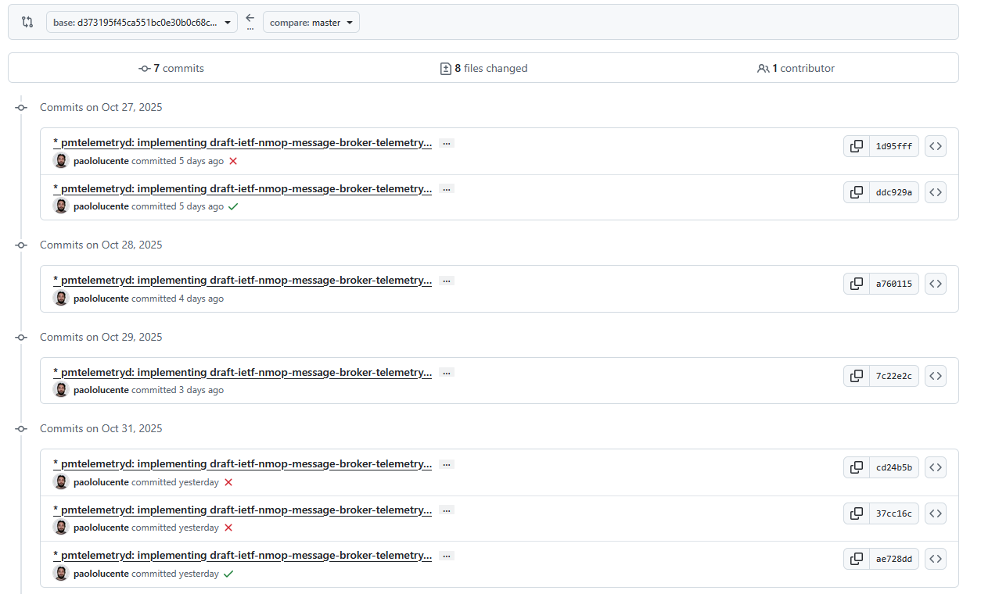
Pmacct – Telemetry Message Support
yanglint-devel -i -t ext yang-modules/ietf-subscribed-notifications.yang yang-modules/ietf-yang-push-revision.yang yang-modules/ietf-yang-push.yang yang-modules/ietf-datastores.yang yang-modules/ietf-udp-notif-transport.yang yang-modules/ietf-yang-push-telemetry-message.yang yang-modules/ietf-telemetry-message.yang yang-modules/ietf-yang-types.yang yang-modules/ietf-yang-revisions.yang yang-modules/ietf-yang-semver.yang yang-modules/ietf-yang-structure-ext.yang yang-modules/ietf-yp-notification.yang yang-modules/ietf-inet-types.yang yang-modules/ietf-yang-types.yang yp210-subscription-started2.json -f json -k ietf-telemetry-message:structure:message
{
"ietf-telemetry-message:message": {
"telemetry-message-metadata": {
"collection-timestamp": "2025-01-01T01:00:30+01:00",
"notification-event": "log",
"session-protocol": "yang-push",
"export-address": "71.19.157.107",
"export-port": 31513
},
"data-collection-manifest": {
"name": "default",
"vendor": "pmacct",
"software-version": "1.7.10-git",
"software-flavor": "20251029-0 (7c22e2cf)"
},
"network-operator-metadata": {
"labels": [
{
"name": "seq",
"string-value": "1"
},
{
"name": "serialization",
"string-value": "json"
}
]
},
"payload": {
"ietf-yp-notification:envelope": {
"event-time": "2025-07-18T09:50:49.505Z",
"hostname": "ipf-zbl1327-r-daisy-91",
"sequence-number": 0,
"contents": {
"ietf-subscribed-notifications:subscription-started": {
"id": 210,
"ietf-yang-push:datastore": "ietf-datastores:operational",
"ietf-yang-push:datastore-xpath-filter": "openconfig-interfaces:interfaces/interface/state/counters",
"transport": "ietf-udp-notif-transport:udp-notif",
"ietf-yang-push-revision:module-version": [
{
"module-name": "openconfig-interfaces",
"revision": "2022-10-25"
}
],
"ietf-yang-push-revision:yang-library-content-id": "6d13bafd8fd1dc21aa8932d1199b369794881393",
"encoding": "encode-json",
"ietf-yang-push:periodic": {
"period": 3000,
"anchor-time": "2025-01-01T00:00:30+00:00"
}
}
}
}
}
}
}
draft-ietf-nmop-message-broker-telemetry-message support has been implemented in Pmacct for IETF 124 hackathon.
Libyang supports YANG data structures as of RFC 8791 as of version 4.0.14. This came as improvement from the IETF 123 YANG-Push validation activities.
NMOP & NETCONF WG

Slide 7
NetGauze – Telemetry Message Support
yanglint-devel -i -t ext yang-modules/ietf-subscribed-notifications.yang yang-modules/ietf-yang-push-revision.yang yang-modules/ietf-yang-push.yang yang-modules/ietf-datastores.yang yang-modules/ietf-udp-notif-transport.yang yang-modules/ietf-yang-push-telemetry-message.yang yang-modules/ietf-telemetry-message.yang yang-modules/ietf-yang-types.yang yang-modules/ietf-yang-revisions.yang yang-modules/ietf-yang-semver.yang yang-modules/ietf-yang-structure-ext.yang yang-modules/ietf-yp-notification.yang yang-modules/ietf-inet-types.yang yang-modules/ietf-yang-types.yang yp210-subscription-started4.json -f json -k ietf-telemetry-message:structure:message
{
"ietf-telemetry-message:message": {
"telemetry-message-metadata": {
"node-export-timestamp": "2025-07-18T11:50:49.505+02:00",
"collection-timestamp": "2025-07-18T11:50:49.503566119+02:00",
"notification-event": "log",
"session-protocol": "yang-push",
"export-address": "203.0.113.91",
"export-port": 31513,
"ietf-yang-push-telemetry-message:yang-push-subscription": {
"id": 210,
"xpath-filter": "openconfig-interfaces:interfaces/interface/state/counters",
"datastore": "ietf-datastores:operational",
"transport": "ietf-udp-notif-transport:udp-notif",
"encoding": "ietf-subscribed-notifications:encode-json",
"periodic": {
"period": 3000,
"anchor-time": "2025-01-01T01:00:30+01:00"
},
"yang-library-content-id": "6d13bafd8fd1dc21aa8932d1199b369794881393"
}
},
"data-collection-manifest": {
"name": "netgauze-yang-push@ietf-col-left01",
"vendor": "NetGauze",
"software-version": "0.7.0 (cba5eb90)",
"software-flavor": "release",
"os-version": "8.10",
"os-type": "Red Hat Enterprise Linux"
},
"network-operator-metadata": {
"labels": [
{
"name": "nkey",
"string-value": "unknown"
},
{
"name": "pkey",
"string-value": "unknown"
}
]
},
"payload": {
"ietf-yp-notification:envelope": {
"contents": {
"ietf-subscribed-notifications:subscription-started": {
"encoding": "ietf-subscribed-notifications:encode-json",
"id": 210,
"ietf-yang-push-revision:module-version": [
{
"module-name": "openconfig-interfaces",
"revision": "2022-10-25"
}
],
"ietf-yang-push-revision:yang-library-content-id": "6d13bafd8fd1dc21aa8932d1199b369794881393",
"ietf-yang-push:datastore": "ietf-datastores:operational",
"ietf-yang-push:datastore-xpath-filter": "openconfig-interfaces:interfaces/interface/state/counters",
"ietf-yang-push:periodic": {
"anchor-time": "2025-01-01T00:00:30Z",
"period": 3000
},
"transport": "ietf-udp-notif-transport:udp-notif"
}
},
"event-time": "2025-07-18T09:50:49.505Z",
"hostname": "ipf-zbl1327-r-daisy-91",
"sequence-number": 0
}
}
}
}
draft-ietf-nmop-message-broker-telemetry-message support has been implemented in Netgauze for IETF 123 hackathon.
Libyang supports YANG data structures as of RFC 8791 as of version 4.0.14. This came as improvement from the IETF 123 YANG-Push validation activities.
NMOP & NETCONF WG

Slide 8

Next Steps from IETF 123 Hackathon…
Yanglint, fix YANG extension's structure support
Pmacct supporting Network Telemetry Message
YANG schema registry supporting YANG features
NetGauze supporting
netconf <get> to obtain YANG library content,
YANG validation for YANG-Push notifications,
YANG schema registration.
NMOP & NETCONF WG

Slide 9
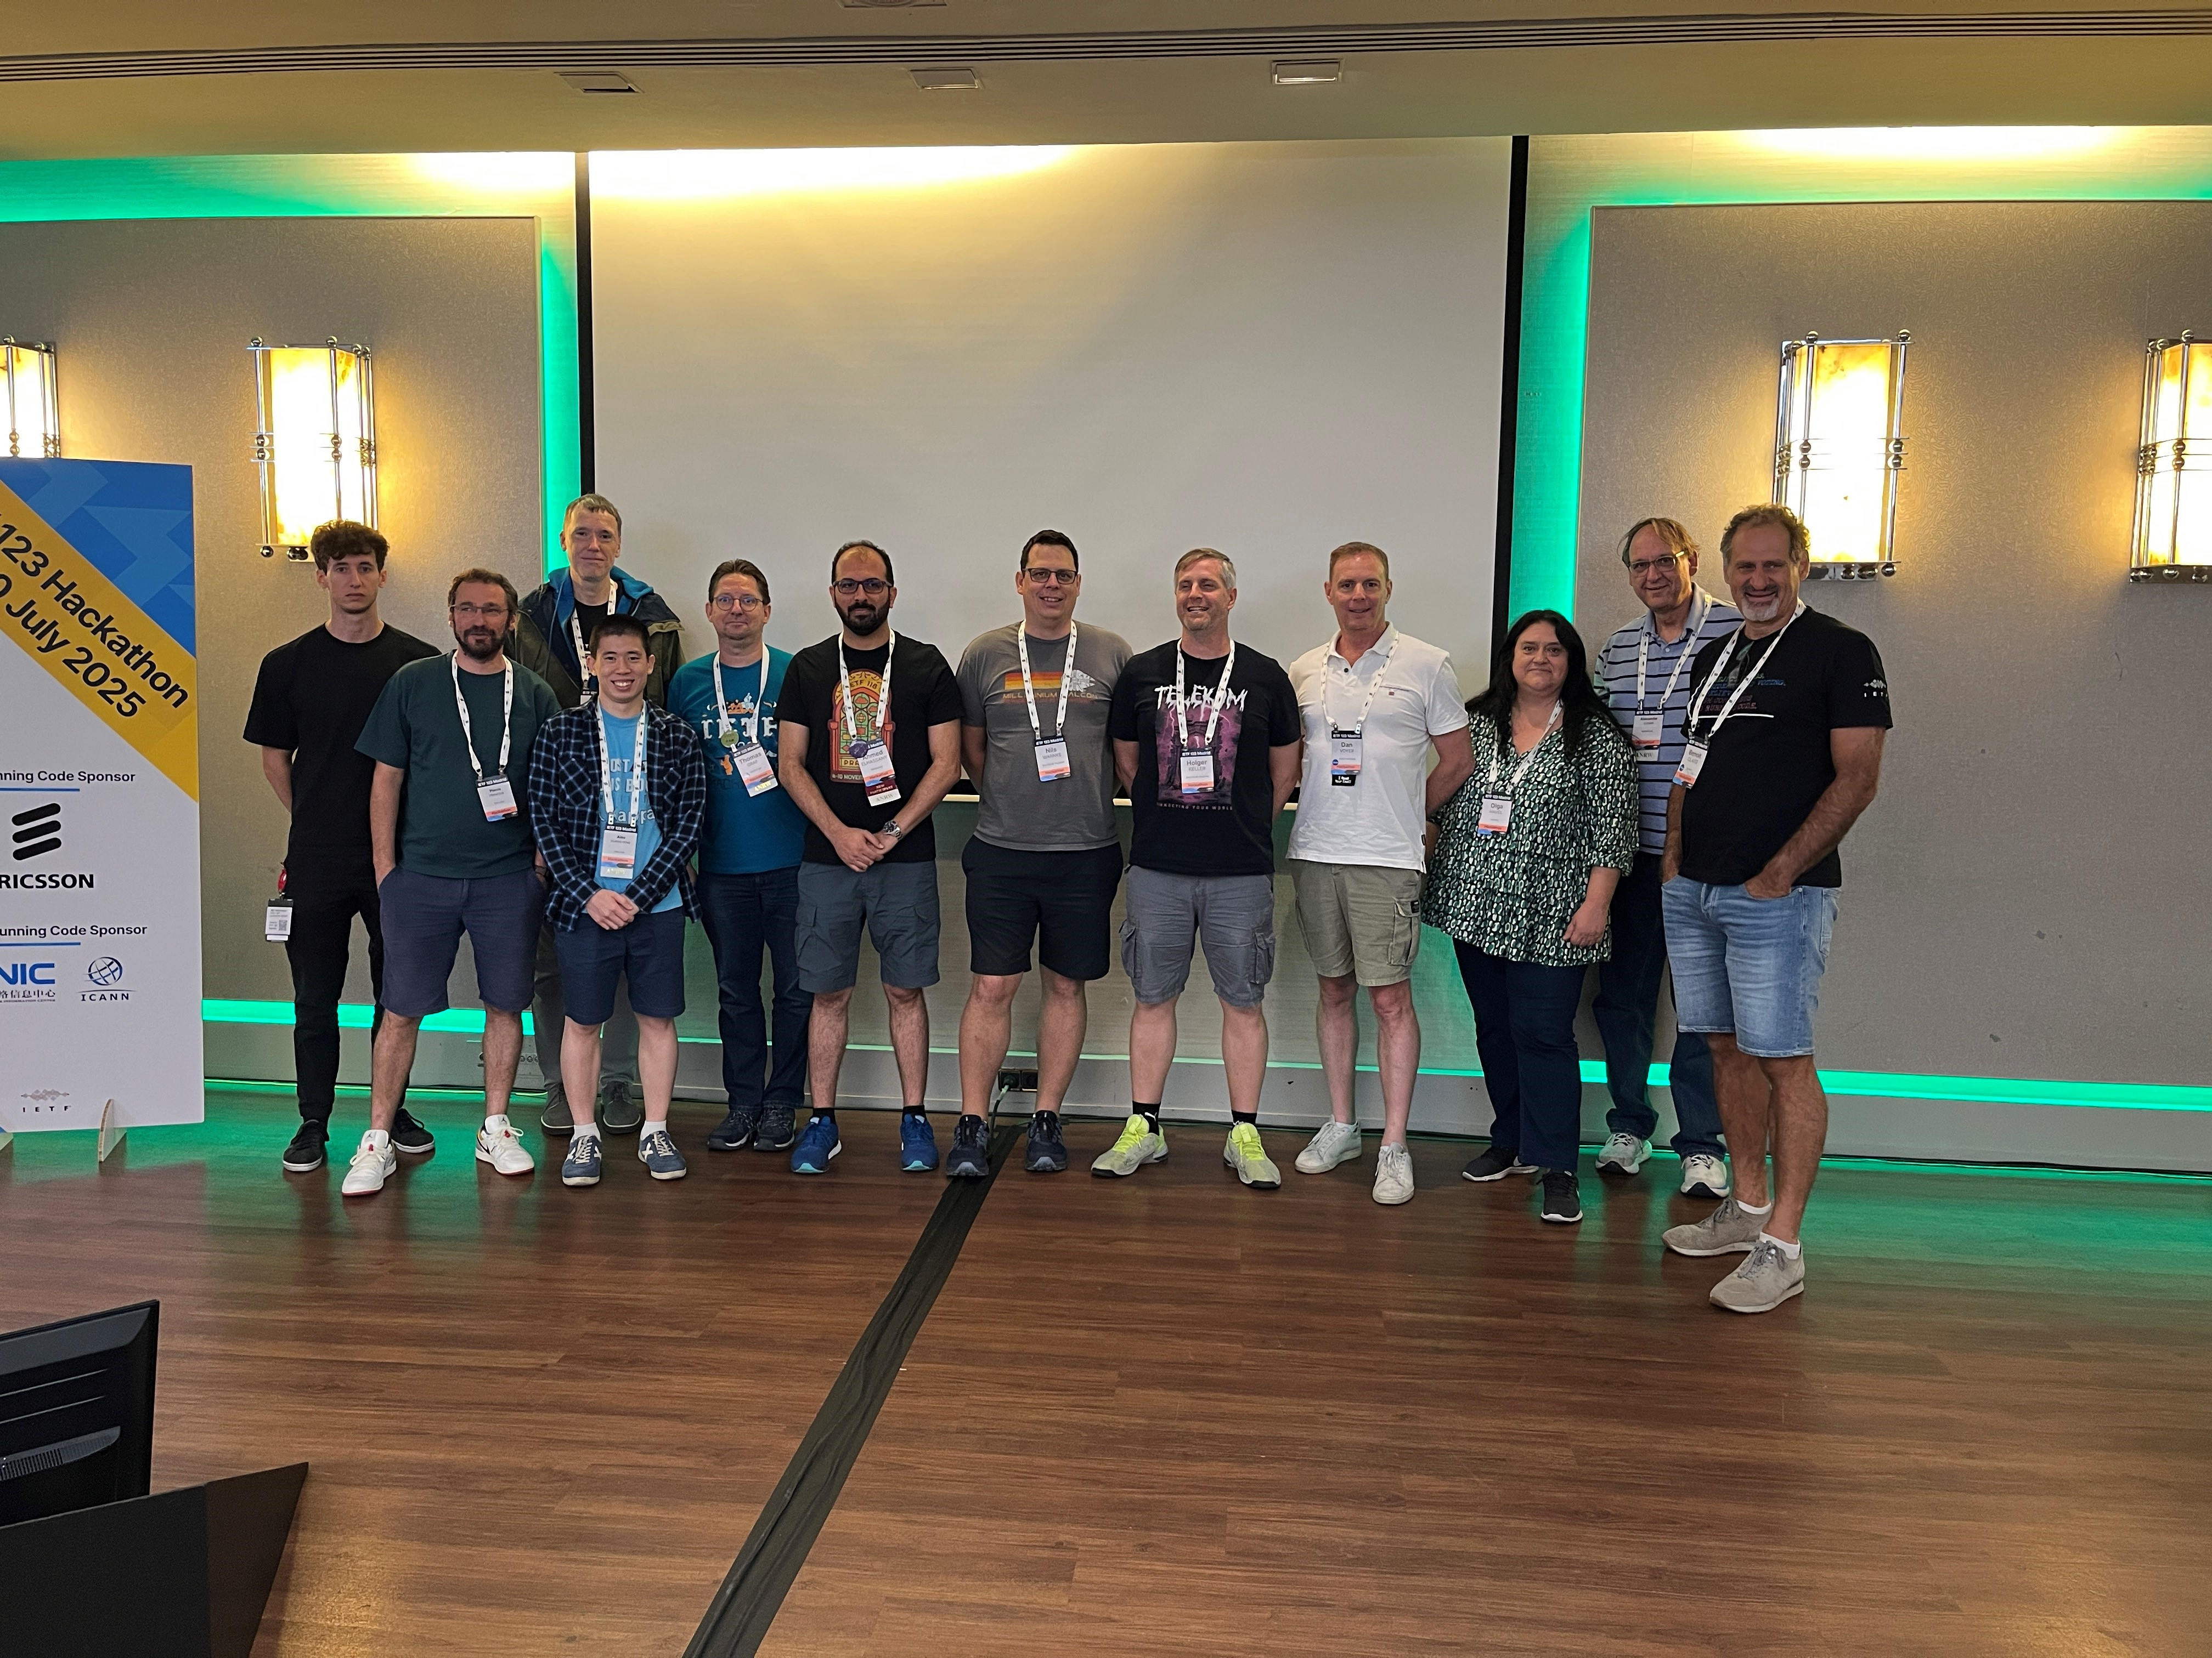
Thanks to…
Paolo Lucente – Pmacct
Maxence Younsi – INSA Lyon
Reshad Rahman - Equinix
Rob Wilton – Cisco
Dan Voyer – Cisco
Holger Keller – DT
Nils Warnke – DT
Benoit Claise - Everything OPS SRL
Yannick Buchs – Swisscom
Ahmed Elhassany – Swisscom
Thomas Graf – Swisscom
NMOP & NETCONF WG
Want to to know more than join us at…
NMOP on Monday 14:30-16:30 at Viger for Message Broker, Telemetry Message and Message Key.
NMOP on Wednesday 14:30 – 15:30 at Agora for more on Telemetry Message integration and validation.
NETMOD on Friday 09:30 – 11:00 at Van Horne for more on YANG anydata validation.

